Slide 1
Predicting Box Office Success through Indicator analysis
TEAM 1ㅣ20190196 김태형
20190361 안선호
20190573 전재완

Slide 2
INDEX
01
Project overview
02
Related Works
03
Data sets
04
Data Analysis
05
Conclusion

Slide 3

01
Project overview

Slide 4





01
Objectives
Project Overview
Ratings
Revenue

Slide 5
01
Objectives
Project Overview
Budget – Revenue
Budget – Ratings
Genre – Earnings rate

Slide 6






01
Problem Statement
Project Overview
21th film industry
20th film industry

Slide 7
02
Related Works

Slide 8
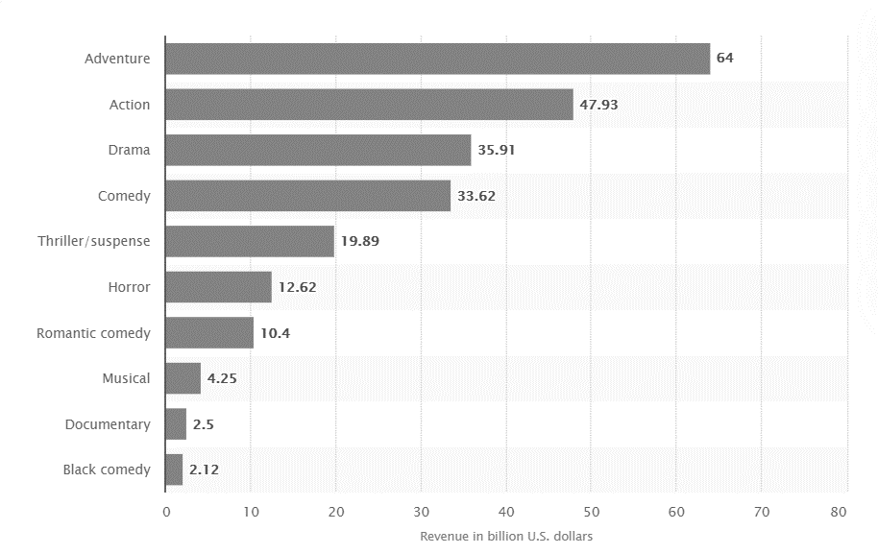
02
“Movie genres ranked by total box office revenue in North America 1995-2021”
Related Works
Genre – Total Revenue

Slide 9
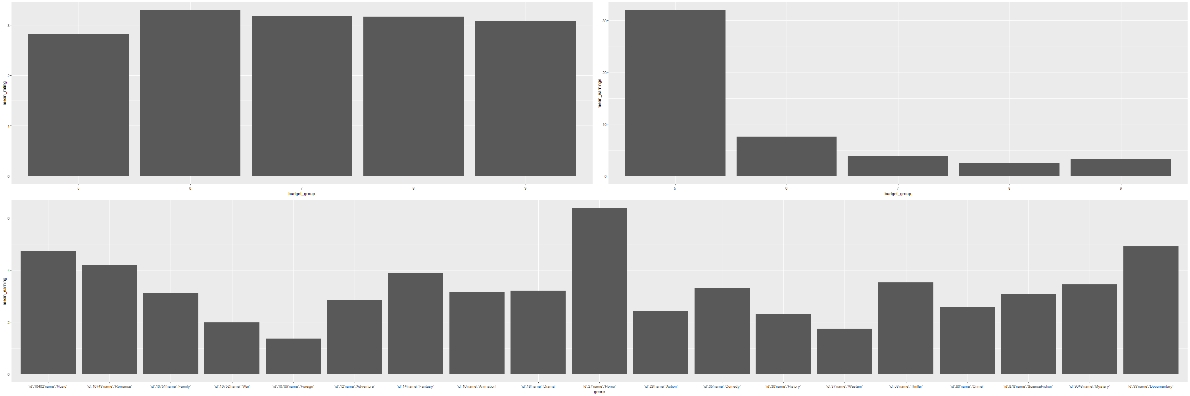
02
“Movie genres ranked by total box office revenue in North America 1995-2021”
Related Works
Genre – Total Revenue
Our Analysis

Slide 10
02
“Movie genres ranked by total box office revenue in North America 1995-2021”
Related Works
Genre – Earnings rate
Music
Horror
Documentary
Genre – Total Revenue
Total Revenue
Earnings rate
Adventure
Action
1st. Adventure
1st. Horror
Drama
2nd. Action
Vs.
2nd. Documentary
Horror
3rd. Drama
3rd. Music

Slide 11
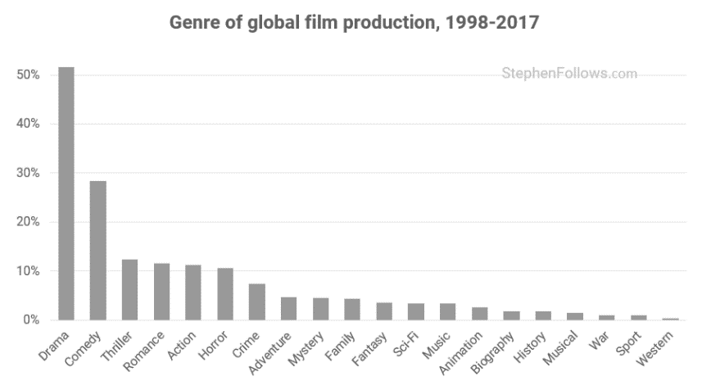
02
“Genre trends in global film production”
Related Works

Slide 12
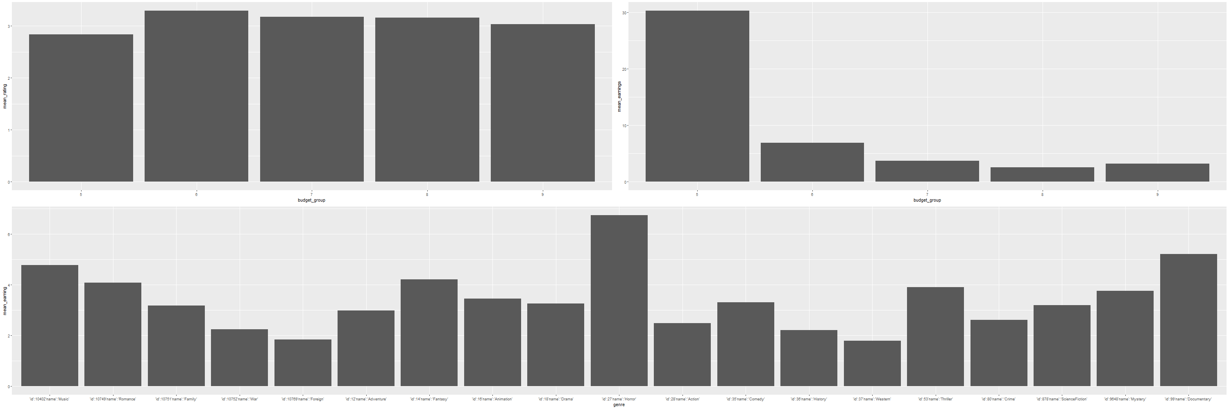
02
“Genre trends in global film production”
Related Works
Our Analysis

Slide 13
02
“Genre trends in global film production”
Related Works
Genre – Earnings rate
Music
Horror
Documentary
Production amount
Earnings rate
Genre – Production amount
1st. Drama
1st. Horror
2nd. Comedy
Vs.
2nd. Documentary
3rd. Thriller
3rd. Music
Drama
Thriller
Comedy
Horror

Slide 14
03
Data Sets

Slide 15


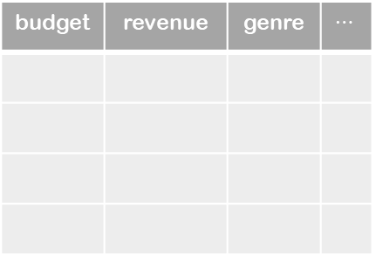
03
Raw Data
Data Sets
Main Dataset
movies_metadata.csv
ratings.csv
budget | revenue | genre | $$⋯$$
userId | movieId | rating | timestamp

Slide 16





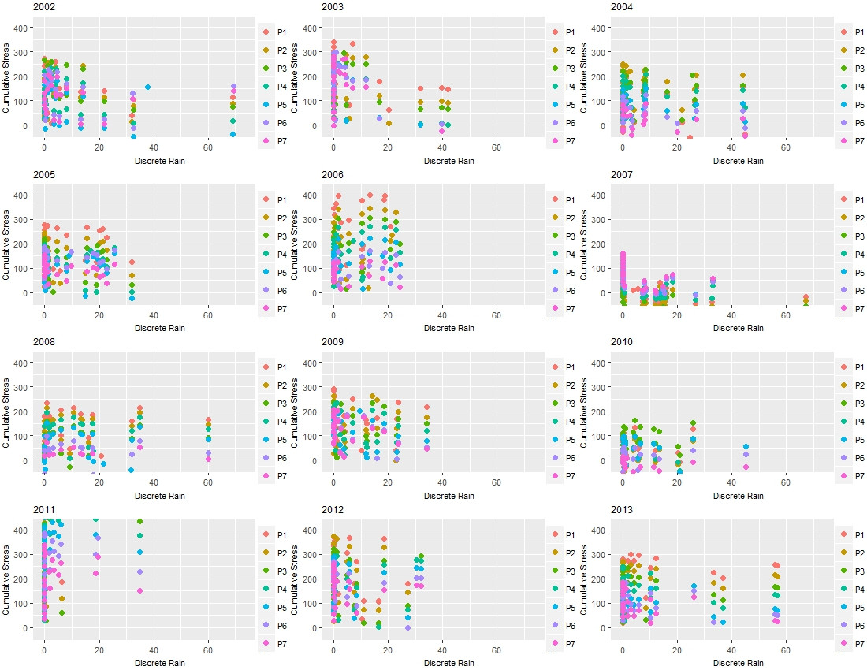

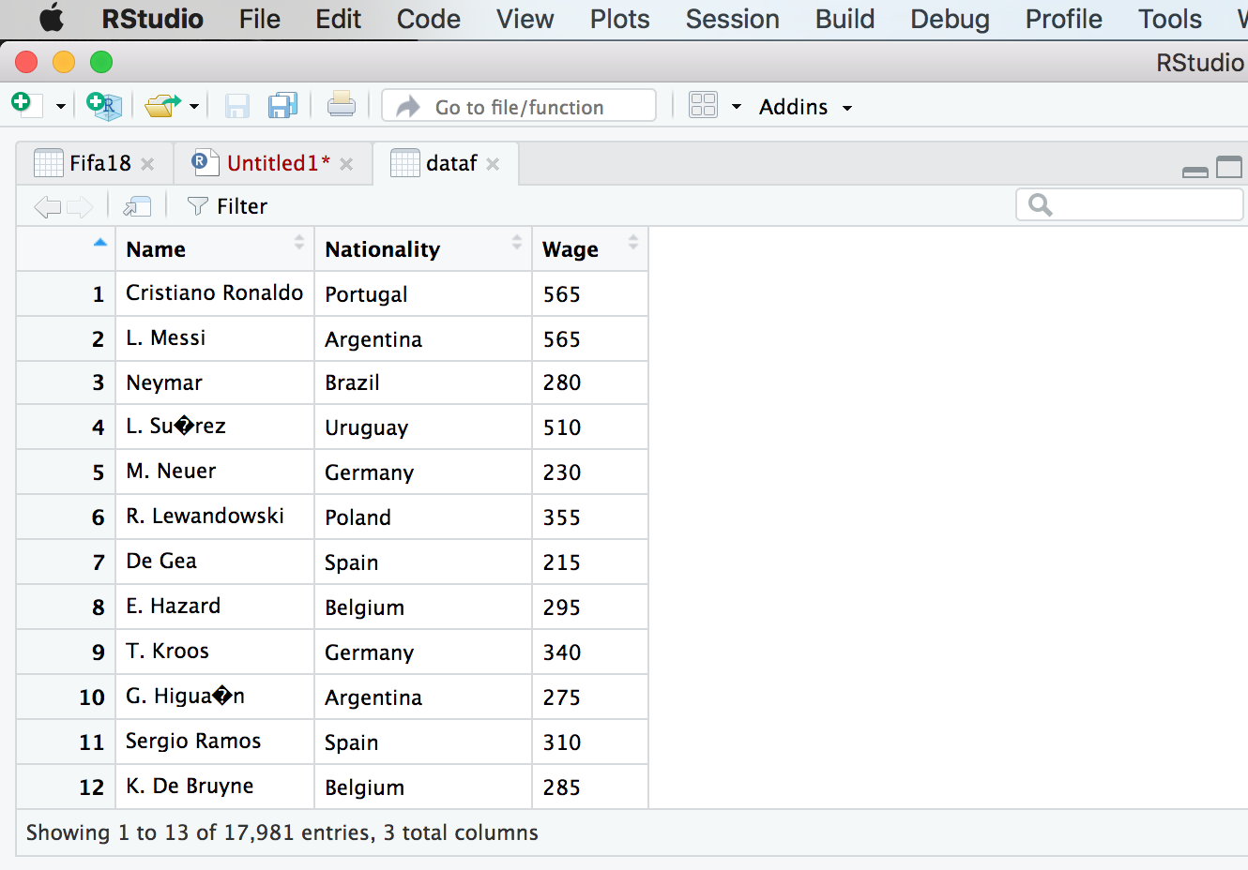

03
Pre-processing for analysis
Data Sets
gridExtra

Slide 17
04
Data Analysis

Slide 18
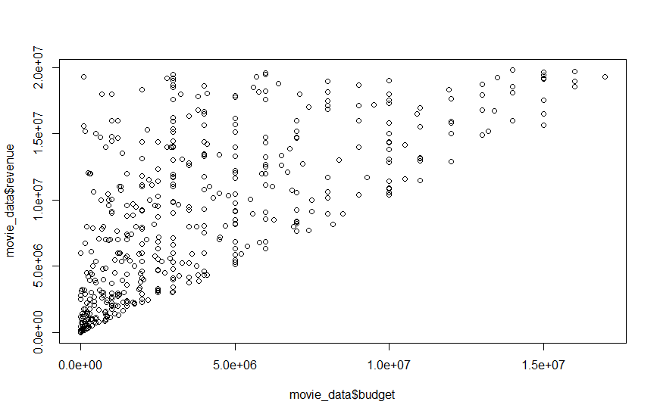
04
Budget - Revenue
Data Analysis
Budget – Revenue Relationship
1. Most movies are located in left-down locations.
2.No significant relationship between budget and revenue, where the earnings ratio is big enough.

Slide 19
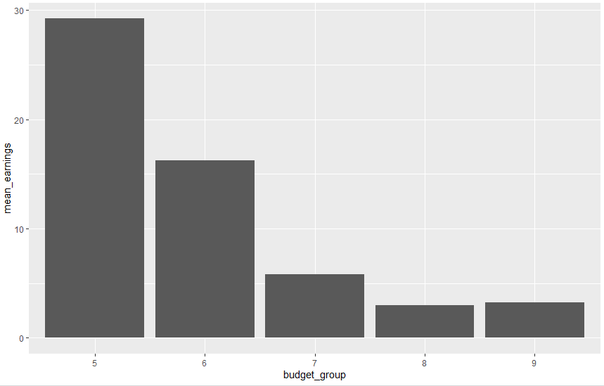
04
Budget - Revenue
Data Analysis
Budget(log scale) – Mean Earnings rate Relationship
Less budget, More earning rate
More budget, Less earning rate

Slide 20
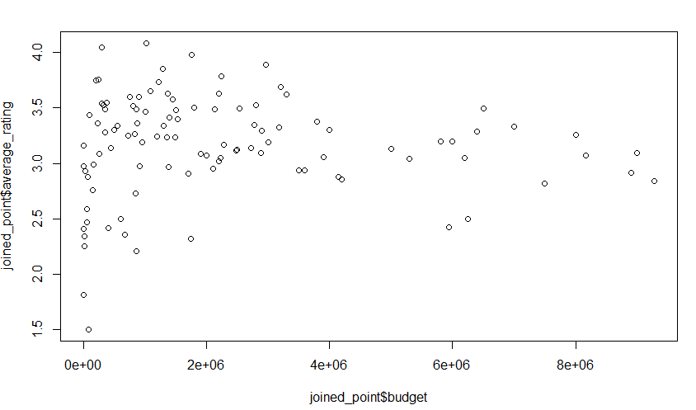
04
Budget - Ratings
Data Analysis
Budget – Ratings Relationship
No significant Relationship!

Slide 21
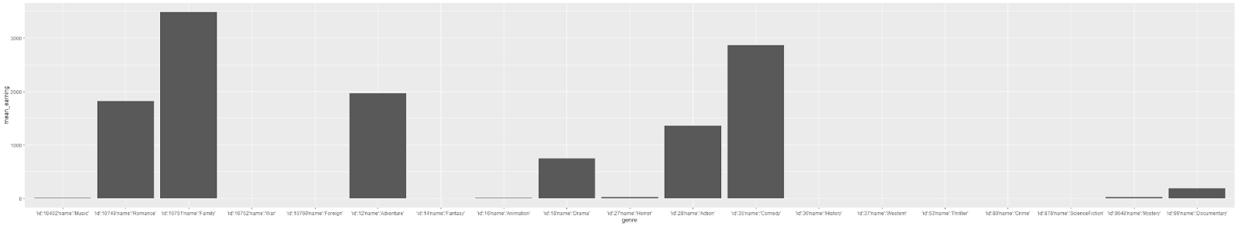
04
Genre - Earnings rate
Data Analysis
Genre - Earnings rate Relationship
documentary
romance
family
action
adventure
Horror
comedy
1. Family and Comedy genres are easy to make a success.
But…
2. Horror genre is one of the least popular.

Slide 22
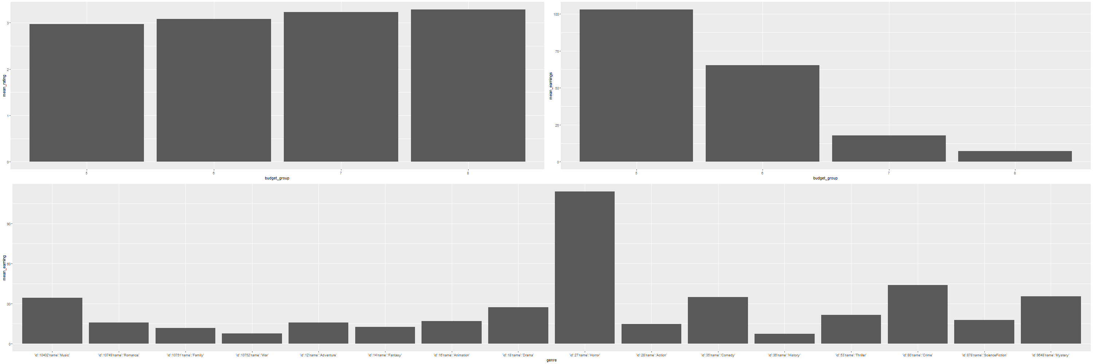
04
Genre - Earnings rate
Data Analysis
Analysis of 70s
horror
Crime
Mystery
1. Horror and Crime genres were easy to make a success at 70s.

Slide 23
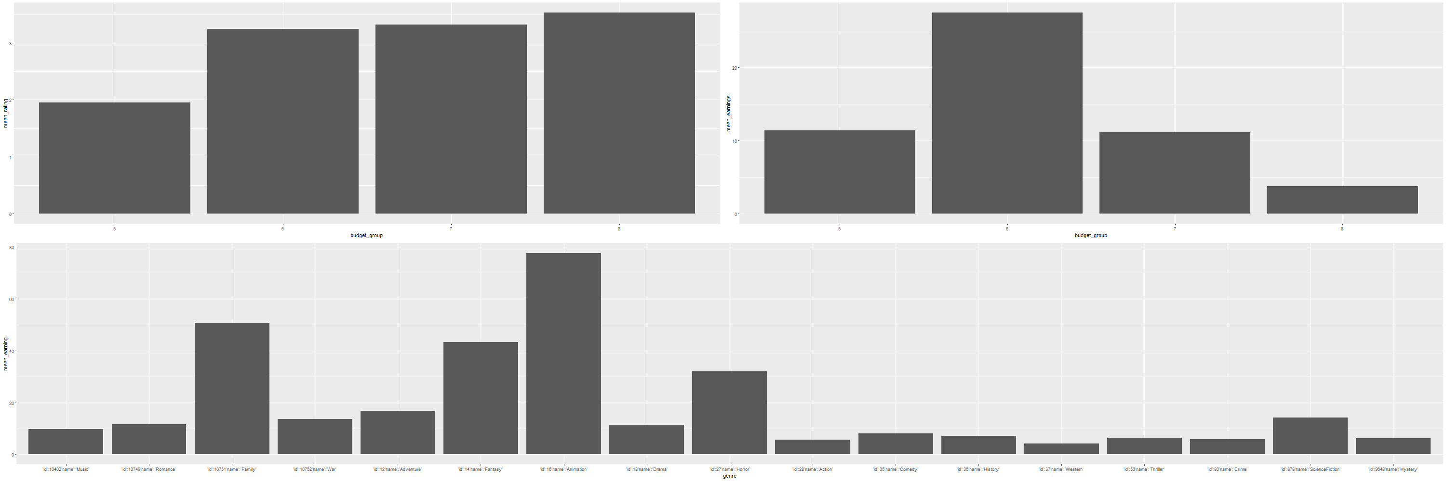
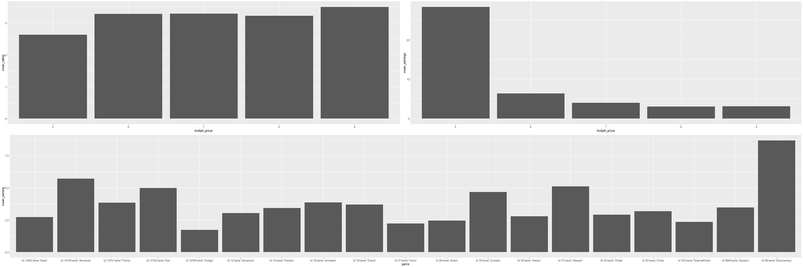
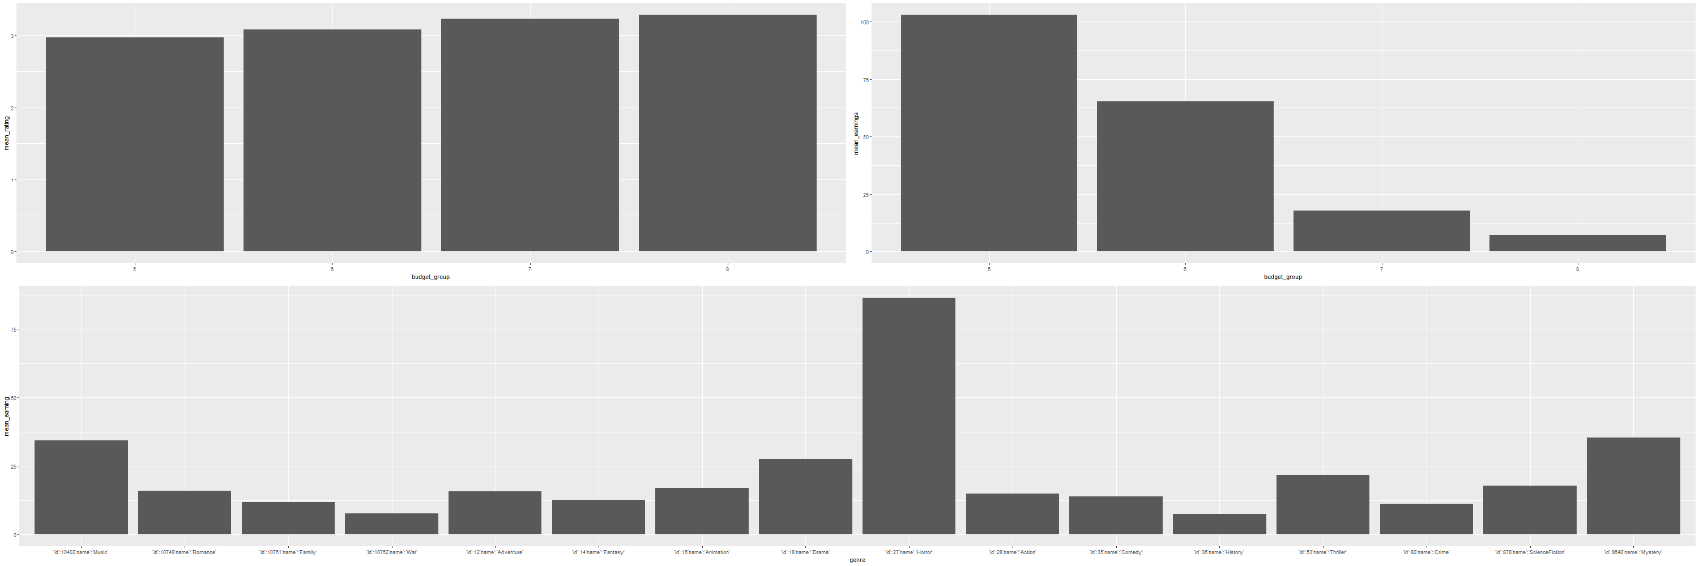
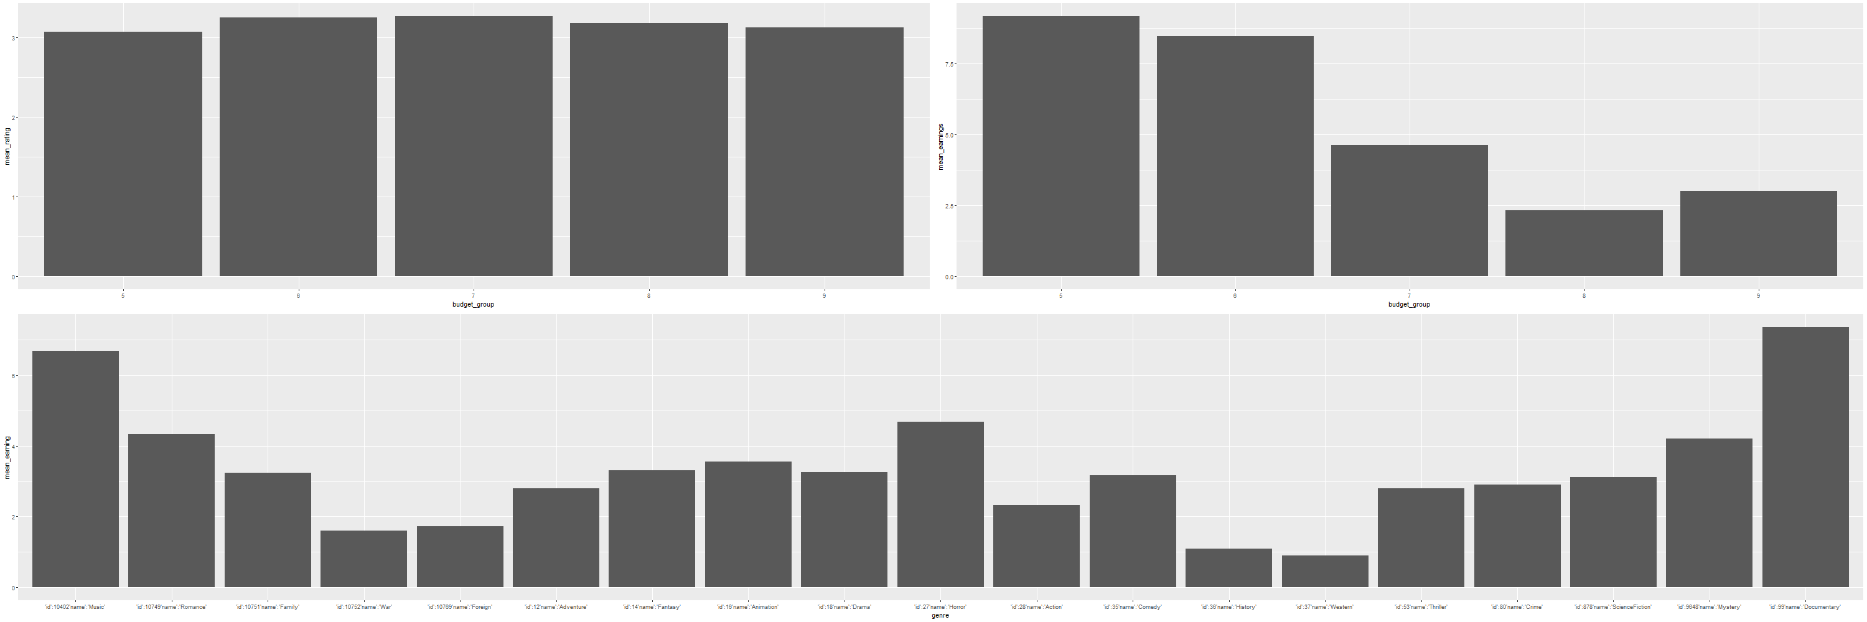
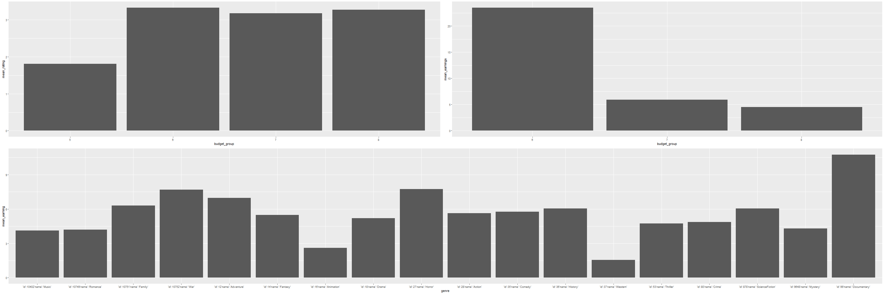
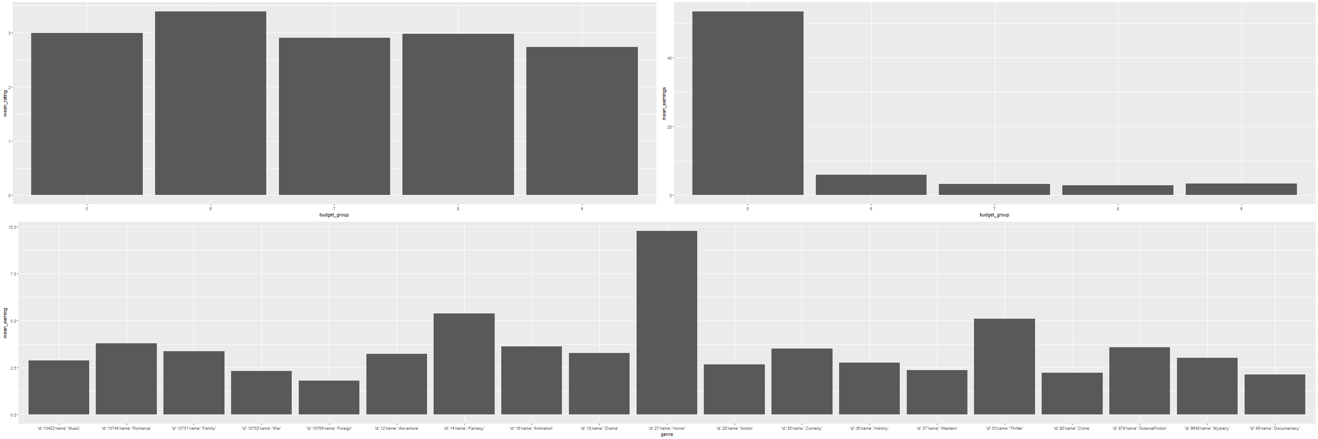
04
Results by Era
Data Analysis
Before 70s
90s
70s
00s
80s
10s

Slide 24
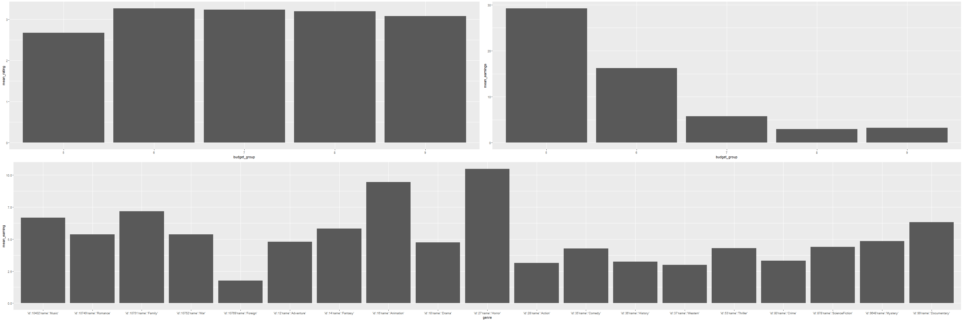
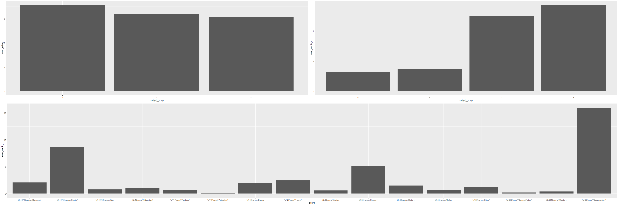
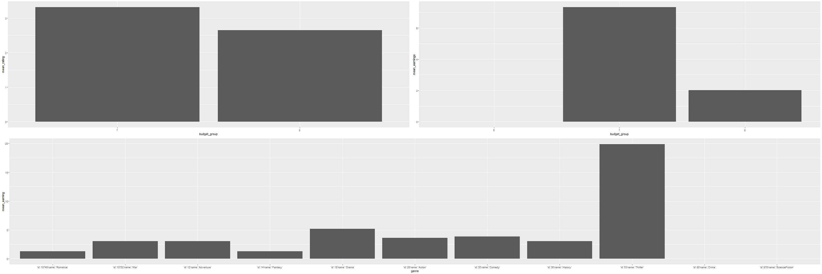
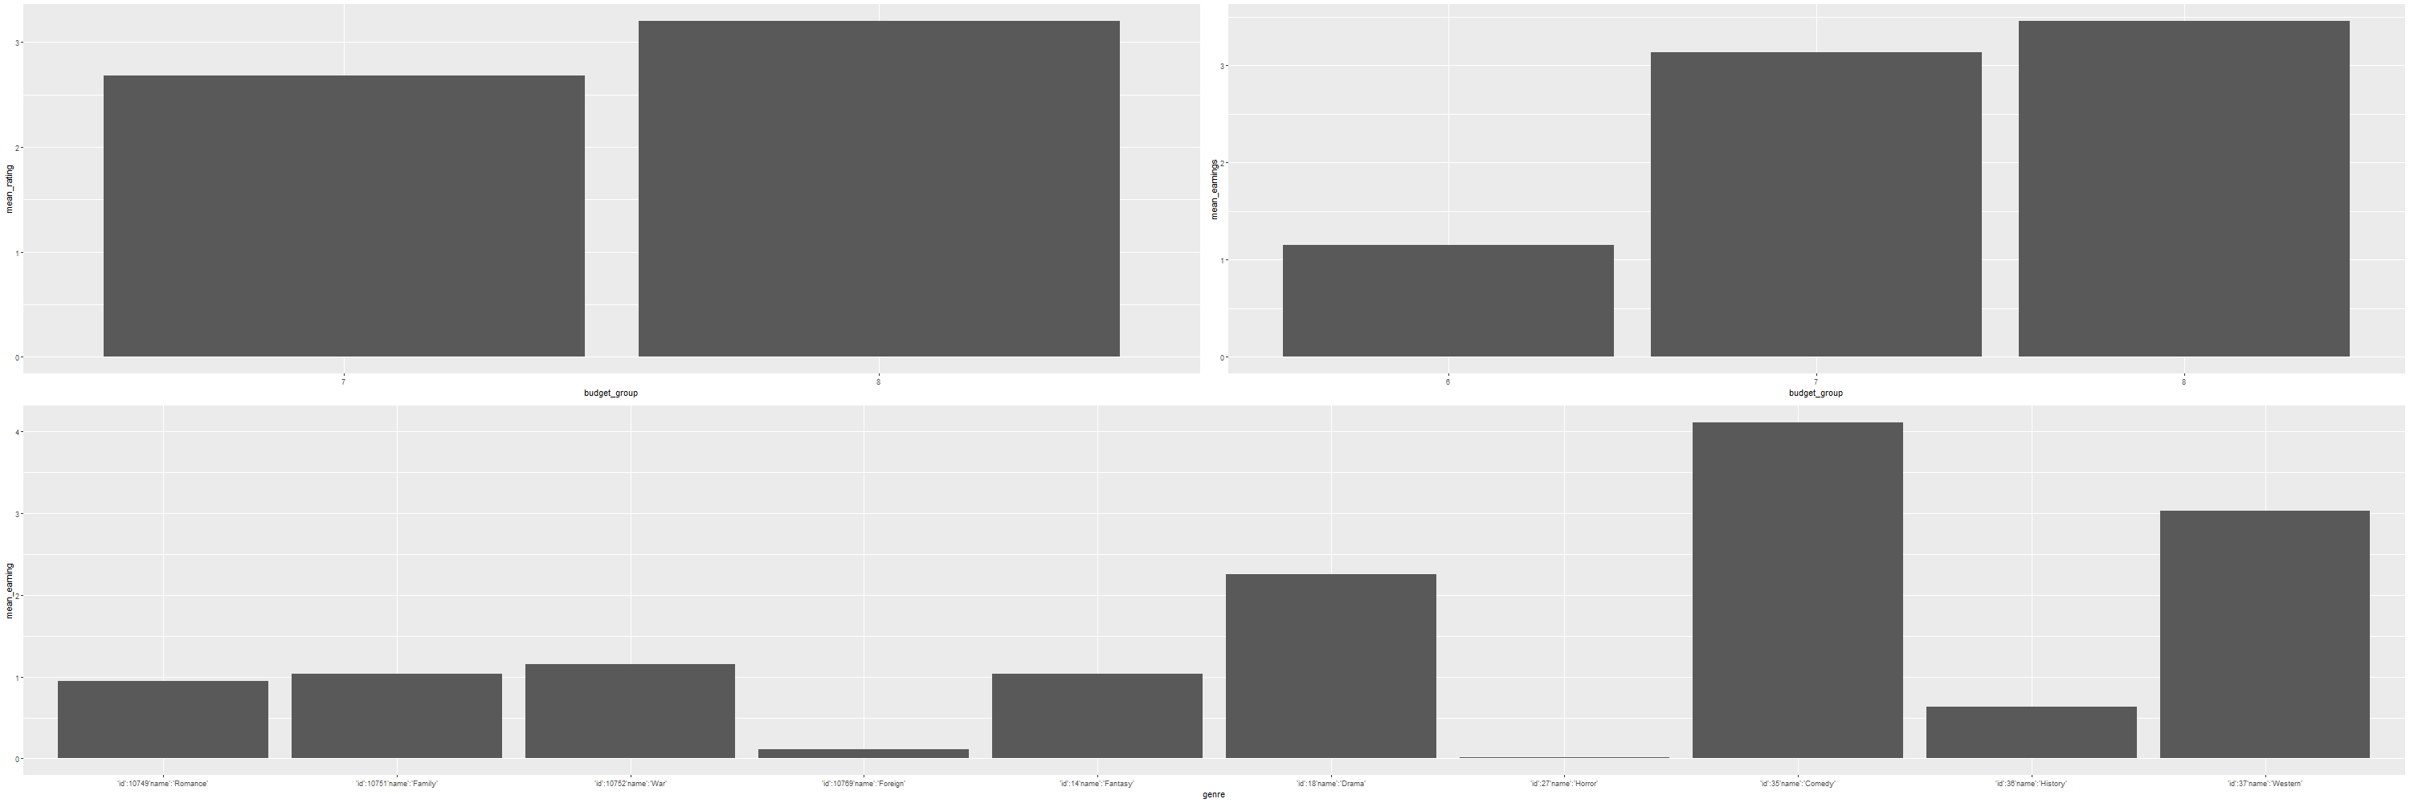
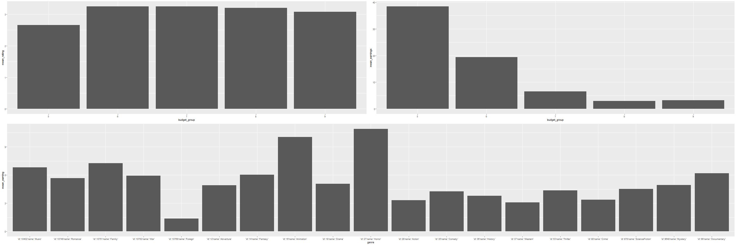
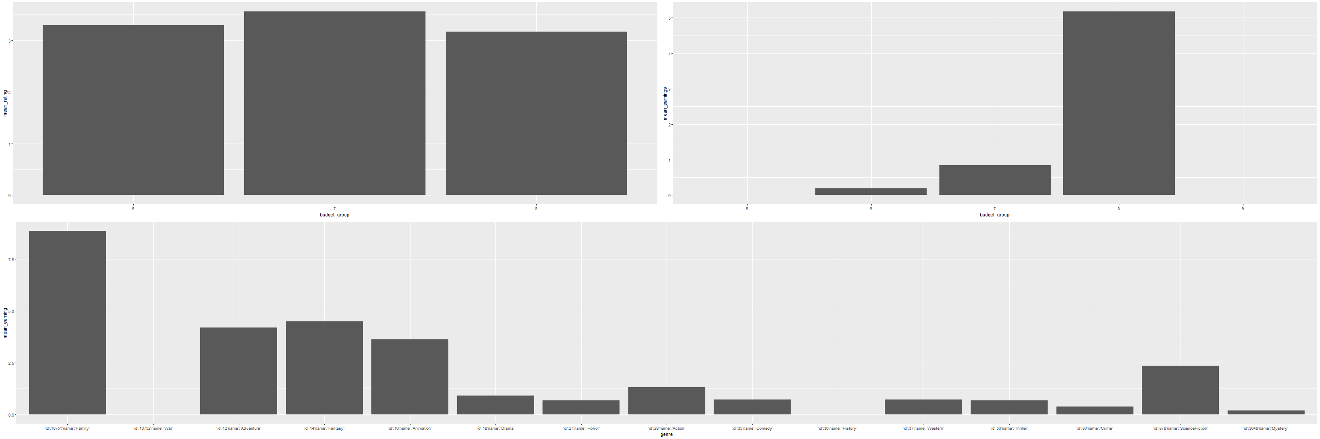
04
Results by Language
Data Analysis
All
French
deutsch
Italian
English
Japanese

Slide 25
05
Conclusion

Slide 26



05
Conclusion
Conclusion
Make analysis on movies for high Earning rate
Low budget movie has high expected Earning rate
No relationship between ratings and budget.
There exist distinctly high Earning rate genres for each era.

Slide 27
Thank you

